Slide 1
British Forces School Naples
Lt Col Robin Hall RE
SO1 Plans and Requirements
16 January 2024

Slide 2
BFS Naples
There are two distinct projects that for the work to BFS Naples.
The interim solution. Delivered by DIO Accn.
This will provide a safe and statutory compliant teaching space and working environment for children and staff.
Works to address the issues with the current school are ongoing.
The Future school provision by UKStratCom
This is the reprovision of the school and associated facilities
Any works undertaken by DIO needs to align with Major Programmes and Projects (MPP) to avoid nugatory work and deliver a cohesive plan.

Slide 3
BFS Naples. The interim solution scope.
To create a safe and compliant teaching and working environment.
The Provision of four new modular classrooms, an office for the Head Teacher and breakout rooms.
The continued use of Villa Victoria as offices, hall and library.
The power to the site, new school server and new classrooms.
Play equipment.
Fixed shading.

Slide 4
BFS Naples. The Interim proposals
The order for the new four new modular classrooms is in process .
This will deliver four purpose built temperature controlled classrooms, Head Teachers office breakout space and well fare facilities.
The target date for delivery of the interim solution is 30 April 2024
This may slip to the first week in May and is dependent on the detailed programme.
Villa Victoria will continue to be used as office and administration support.
The large sunshade areas will be relocated as part of the works.
Wooden play equipment.

Slide 5
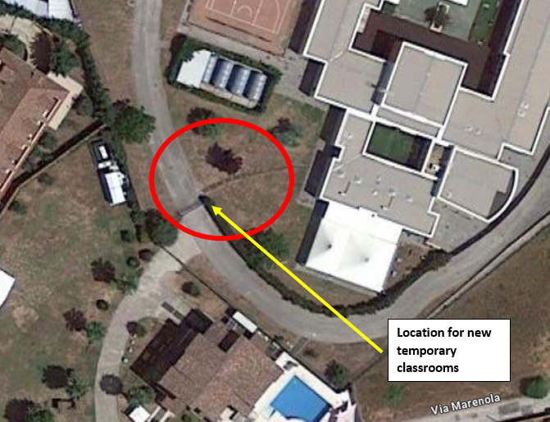
BFS Naples. The Interim proposals location

Slide 6
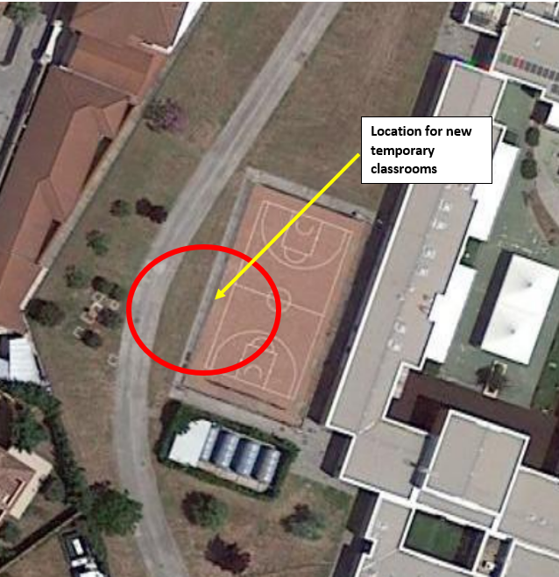
BFS Naples. The Interim proposals location

Slide 7
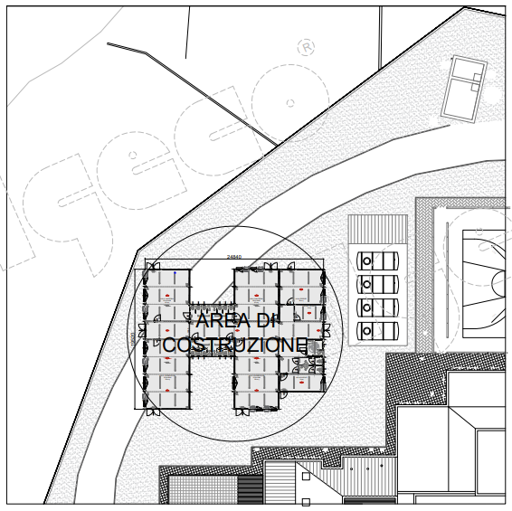
BFS Naples. The Interim proposals Classrooms

Slide 8
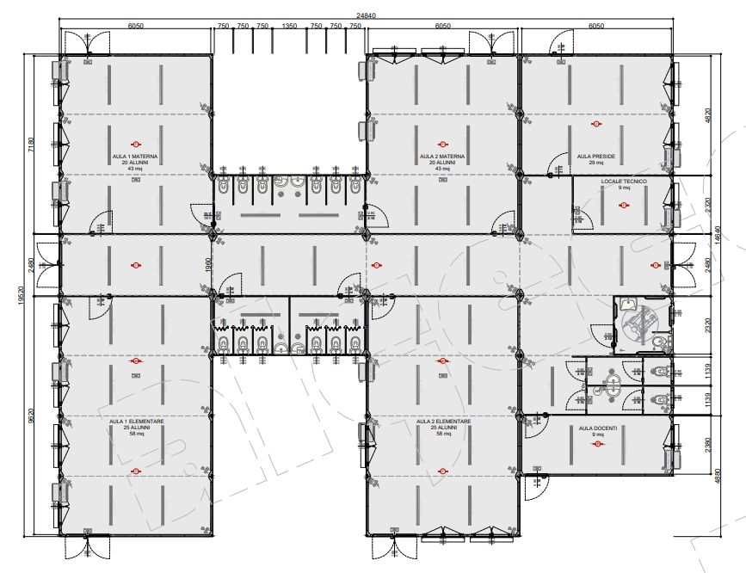
BFS Naples. The Interim proposals Classrooms
Classrooms
Office
Breakout space and welfare
Classrooms

Slide 9
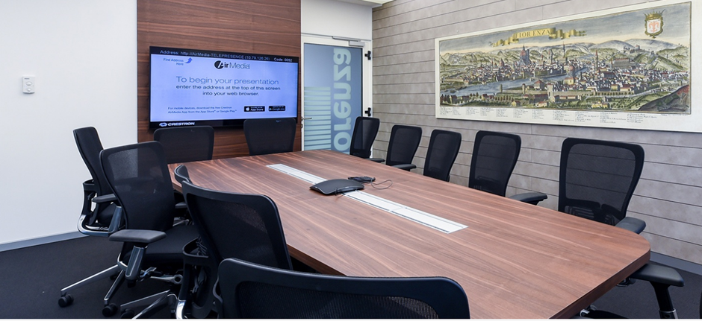
BFS Naples. The Interim proposals Classrooms

Slide 10
BFS Naples. The Interim proposals
QUESTIONS

